Slide 1
Blind estimation of acoustic transfer functions (ATFs) and dereverberation based on convolutive transfer functions (CTFs) Date：2024. 04. 24
Telecom Electroacoustics Audio(TEA) Lab
Presenter:
Anchi Yuan
Notes:
Hello everyone
I’m today’s presenter siang. I’m going to share some of my present work in source separation problem. My topic is comparative studies of source separation using semi-blind and blind source separation approaches.

Slide 2
Outline
Localization procedure
Simulation setting
Simulatio result

Slide 3
Localization procedure
Freefield plane wave model for MPDR angle-wise localization
Check array output power has global maximum or not
Array output power as objective function for golden section search method (GSS)
Freefield point source model for MUSIC distance-wise localization
Check pseudo-spectrum magnitude has local maximum or not
pseudo-spectrum magnitude as objective function for golden section search method (GSS)

Slide 4
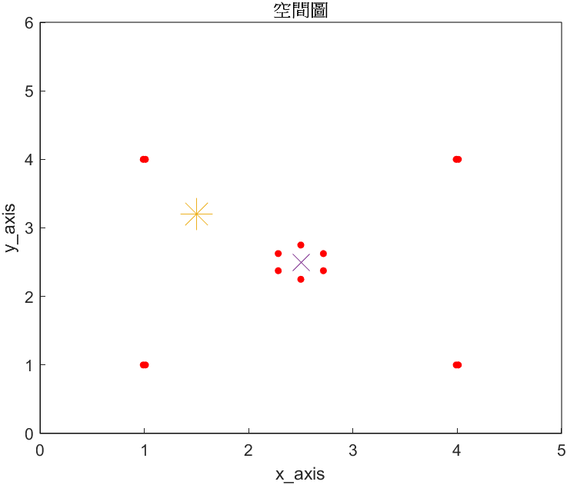

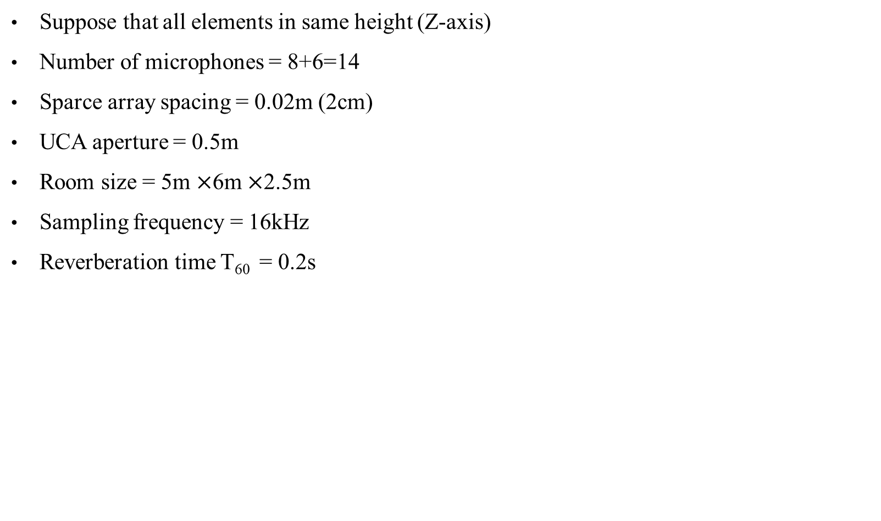
Simulation settings
Suppose that all elements in same height (Z-axis)
Number of microphones = 8+6=14
Sparce array spacing = 0.02m (2cm)
UCA aperture = 0.5m
Room size = 5m $×$6m $×$2.5m
Sampling frequency = 16kHz
Reverberation time T₆₀ = 0.2s
Y-axis (m)
Source
Mics
Array center
X-axis (m)

Slide 5
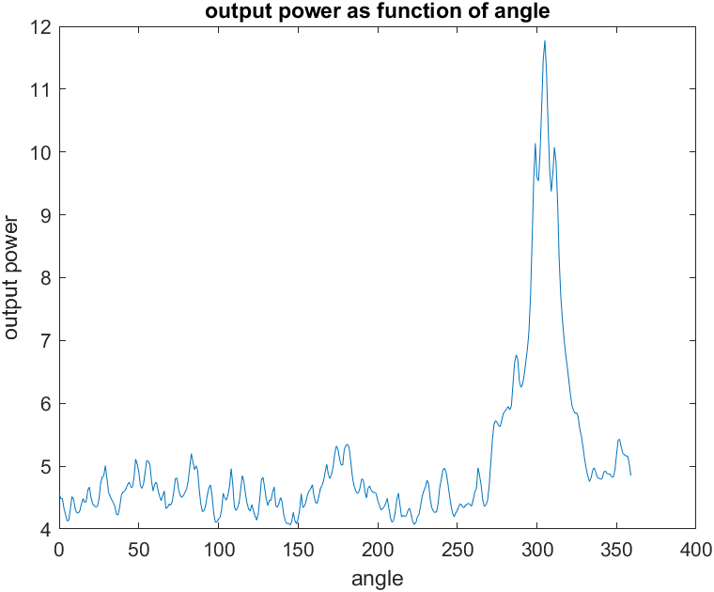
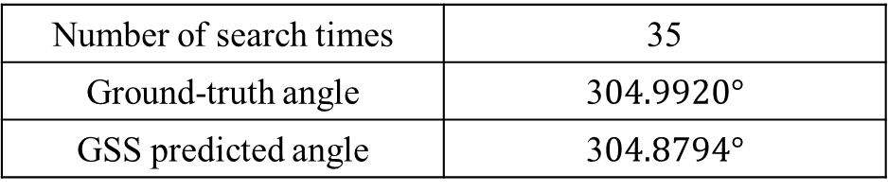
Simulation result (angle)
Number of search times | 35
Ground-truth angle | 3$04.9920°$
GSS predicted angle | 3$04.8794°$

Slide 6
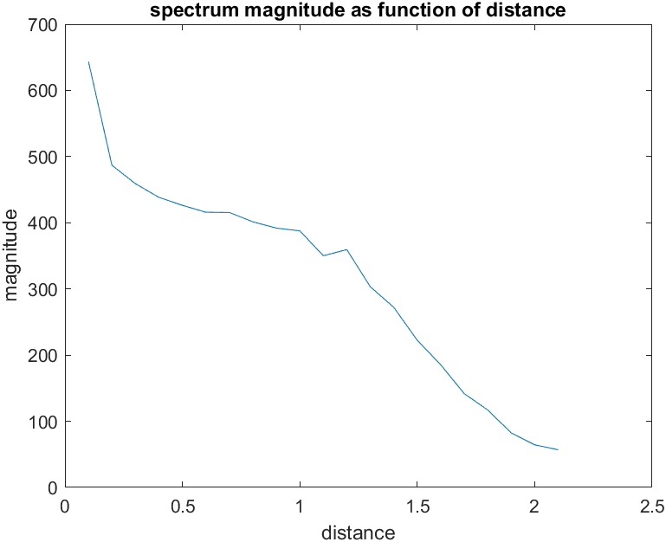
Simulation result (distance)
Number of search times | 31
Ground-truth angle | 1.2207 m
GSS predicted angle | 1.2214 m

Slide 7
